Slide 1

BITE’21 – AI – Day 1

Slide 2
Topics Covered
Introduction to Artificial Intelligence
Introduction to Machine Learning
Introduction to Deep Learning
Difference between AI, ML and DL
Types of Machine Learning
Machine Learning Lifecycle
Roles in Machine Learning
Skills required for Machine Learning

Slide 3
Artificial Intelligence
Artificial intelligence (AI) refers to the simulation of human intelligence in machines that are programmed to think like humans and mimic their actions.
AI is a relatively old term with history tracing back to fictional works dating centuries back
Artificial Intelligence is classified as:
Narrow AI: Narrow AI applications focus on one problem and can perform only the task that they are trained exclusively. For example: Churn prediction system can only predict if a customer would churn out.
General AI: Artificial general intelligence focuses on building intelligent systems that can handle any task or problem in any domain. The promise of AGI remains unfulfilled, but the drive toward the technology pushes the abilities of AI.

Slide 4
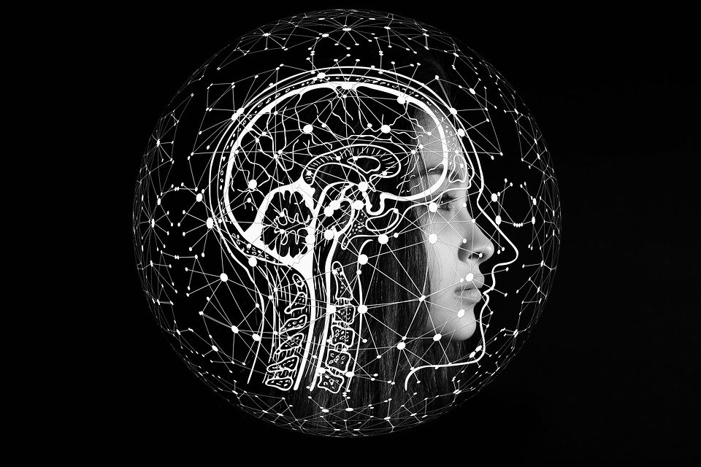
Artificial Intelligence
CNN
Deep Learning
Mimic Human Brain
RNN
Ability to See
Ability to understand pattern and Learn
Computer Vision
Image Processing
Machine Learning
Ability to Speak
Supervised
Reinforcement
Unsupervised
Semi Supervised
NLP or NLU
Ability to Hear
Ability to move around
Speech Recognition
Artificial intelligence (AI) refers to the simulation of human intelligence in machines that are programmed to think like humans and mimic their actions.
Robotics
IOT

Slide 5
Machine Learning
Machine learning involves computers discovering how they can perform tasks without being explicitly programmed to do so
Input Data
Input Data
Output Data
Logic
Logic
Output Data
Traditional Programming
Machine Learning

Slide 6
Math World
Input 1 | Input 2
2 | 3
3 | 4
4 | 5
5 | 6
6 | 7
Output
6
12
20
30
?

Slide 7
Data Science World
Math World
Feature 1
Feature 2
Target
Target1
Target2
Input 1 | Input 2
2 | 3
3 | 4
4 | 5
5 | 6
6 | 7
Output
6
12
20
30
42
Output
31
73
141
241
379
Output
39
100
205
366
595
Observation 1
Observation 2
Observation n
x^2 + x^3
x^2 +x^3+ y^3
Model
Target = Feature1 * Feature 2

Slide 8
Machine Learning
A computer program is said to learn from experience E with respect to some class of tasks T and performance measure P if its performance at tasks in T, as measured by P, improves with experience E
Say, Task is identify Spam emails in Mailbox and Performance is the number of emails detected as spam correctly. Experience is the number of times algorithms iterate over emails and a computer program is said to learn if number of spam emails detected increases with the number of emails received over time

Slide 9
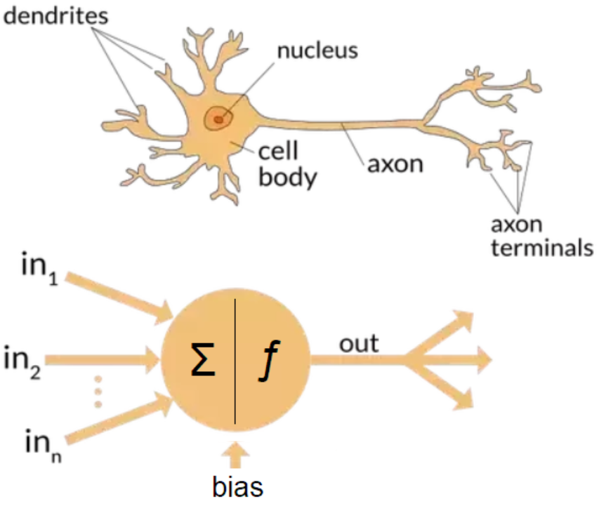
Deep Learning
Deep learning is an artificial intelligence (AI) function that imitates the workings of the human brain in processing data and creating patterns for use in decision making

Slide 10
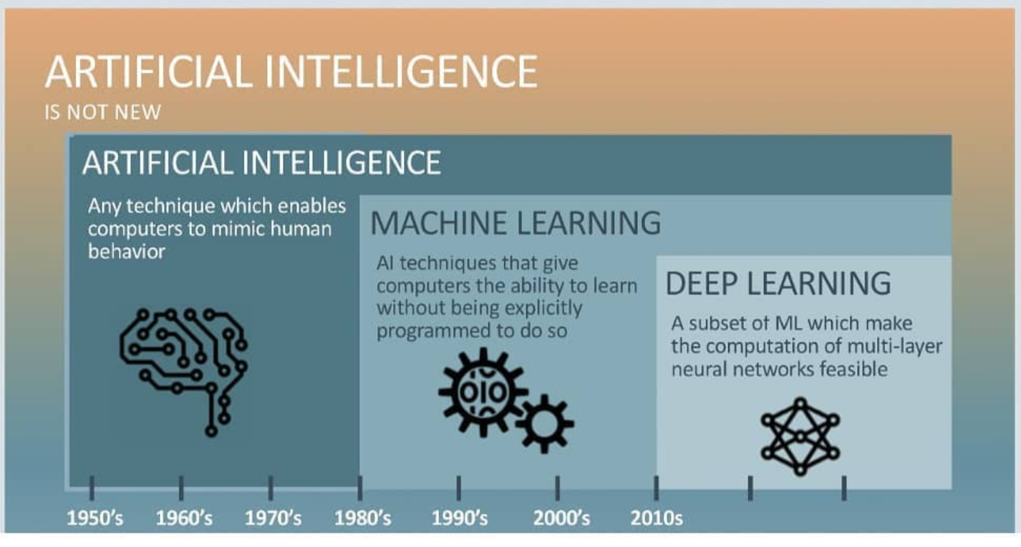
AI vs ML vs DL

Slide 11
Types of Machine Learning
Machine Learning is broadly classified into following classes:
Supervised Machine Learning
Unsupervised Machine Learning
Reinforcement Machine Learning
Deep Learning

Slide 12
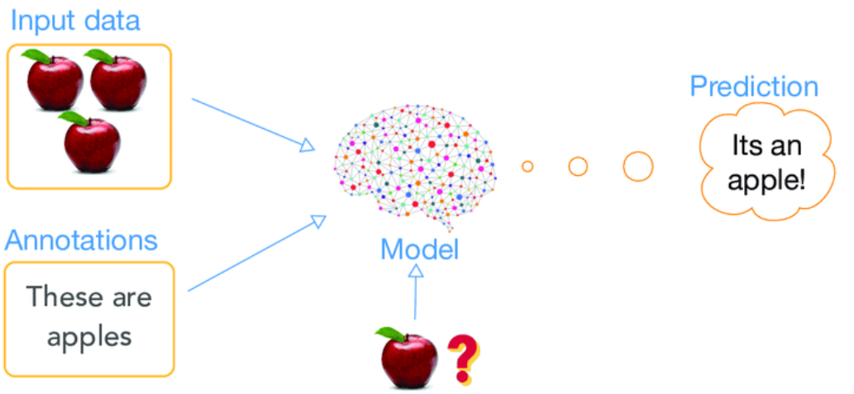
Supervised Machine Learning

Slide 13
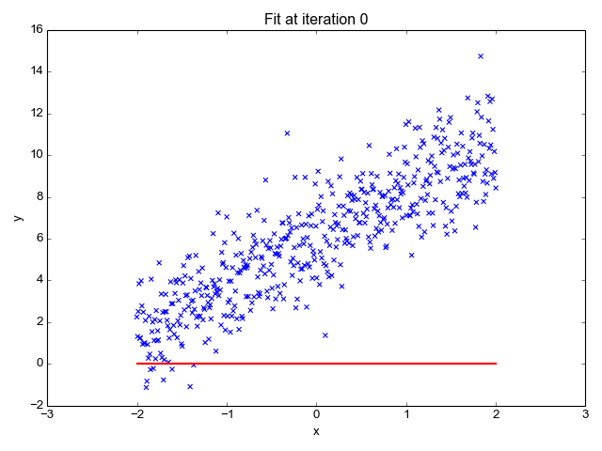
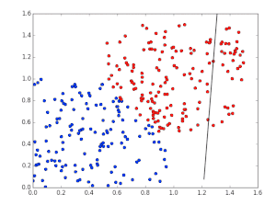
Supervised Machine Learning
Regression
Classification

Slide 14
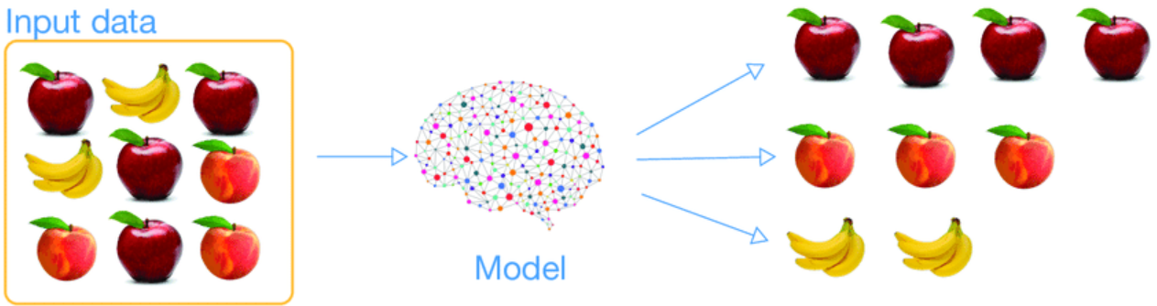
Unsupervised Machine Learning

Slide 15

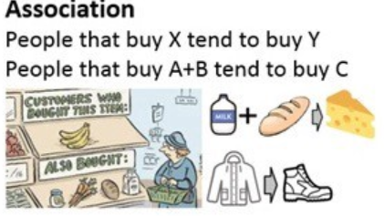
Unsupervised Machine Learning
Association
Clustering

Slide 16


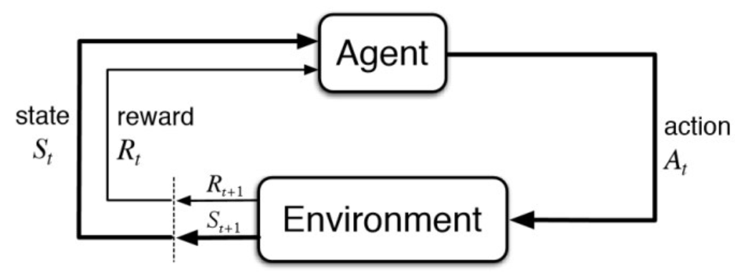
Reinforcement Machine Learning

Slide 17

Neural Networks

Slide 18
Machine Learning Lifecycle

Slide 19
Provide customized offers to customers
Machine Learning Lifecycle
Business Problem
Data Collection
Data Preparation
Exploratory Data Analysis
Modelling
Model Evaluation
Model Deployment
Conduct Survey
Purchase History
…
Deploy to Production
Monitor performance in production
₹ , € , $
Same customer, multiple bills
Model performance
Error rate
Accuracy, Precision, Recall
Average purchase amount
Least sold item
Total sales per month
Classification / Regression
Supervised / Unsupervised
Different Algorithms

Slide 20
Machine Learning Lifecycle
Business Problem
Data Collection
Data Preparation
Exploratory Data Analysis
Modelling
Model Evaluation
Model Deployment
Data Acquisition
Knowledge of Databases
ETL Processes
Data Engineer
Machine Learning Techniques
Deep Learning Techniques
AI Frameworks like Keras, Tensorflow, PyTOrch, H20
Deployment Frameworks, like Flask, Django
Machine
Learning
Engineer
Data Analyst
Domain Knowledge
Statistics
Data Analysis – R, Pythion, SAS
Data Visualization – Tableau, Matplotlib

Slide 21
Machine Learning Lifecycle
Business Problem
Data Collection
Data Preparation
Exploratory Data Analysis
Modelling
Model Evaluation
Model Deployment
Data Scientist

Slide 22
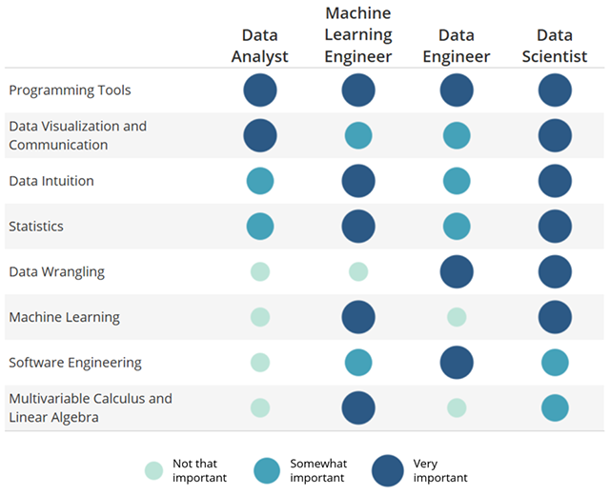
Skills Required

Slide 23




















Build
Model
Data Storage
Visualize
Data
Data Analysis

Slide 24
Conclusion
Understood about Artificial Intelligence, Machine Learning, Deep Learning and how they differ from each other
Learnt different types of Machine Learning algorithms
Learnt about the end to end Machine Learning Lifecycle and various stages
Learnt about different roles in Machine Learning
Learnt about the responsibilities of each role in Machine Learning
Learnt about the skills required for each role in Machine Learning

Slide 25
Thank You!
Keep learning Keep exploring
www.elitetechnogroups.com

